Slide 1

Introduction to the Microbiome Package for R
By: Moaaz Moazzam and Tenzin Jordan Shawa

Slide 2
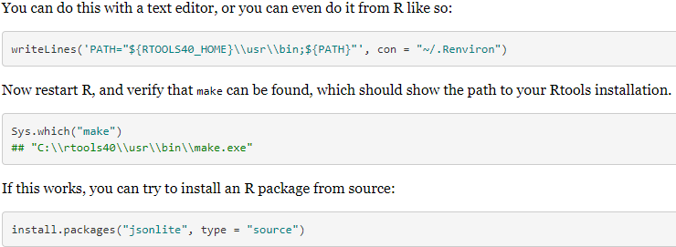

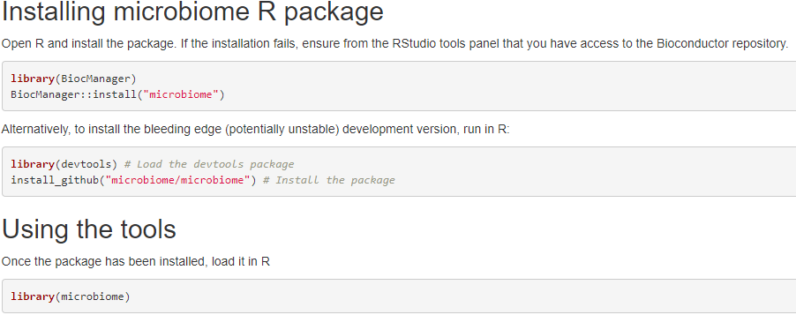
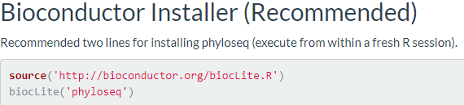

Installing the Microbiome Package
First install R.
Install an IDE such as RStudio
Furthermore, install RTools.
Install Bioconductor.
Then the Microbiome library can be installed.
Lastly, install the Phyloseq, vegan, dplyr, tidyverse, and MicrobeDS libraries.

Slide 3
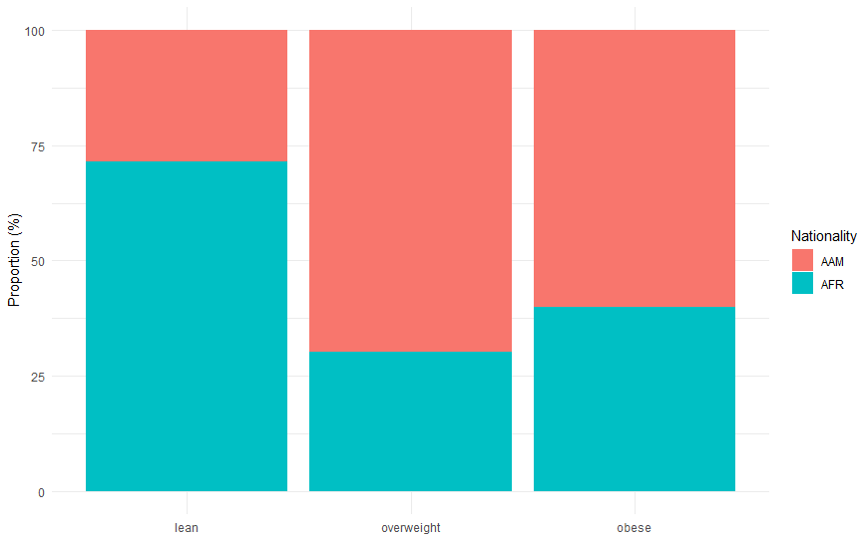
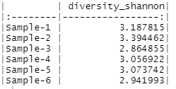
Brief Intro to the Microbiome Package
Package provides tools and functions for the statistical analysis of metagenomic and microbial data.
Alpha Diversity
Beta Diversity
Visualization of data is also a component of the package.

Slide 4
Fundamental Information
Metagenomics is concerned about the study of genomics that are curated from a variety sites or in this case microbiomes.
Microbiome can be seen as microscopic microbial environments such as the human intestines.
Taxonomic profiling is the process of determining the abundance and the classification of the various samples present

Slide 5
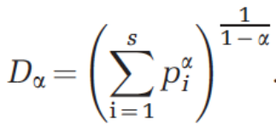
Alpha Diversity
In terms of microbiomes, Alpha Diversity can be seen as the measure of variation between microbes in a single sample set.
Variation can be measured in several ways: Richness, Evenness, and Dominance
Iterations of the Alpha value affect the diversity index, along with the variations between the species.
"alpha()" function or "diversities()" function.

Slide 6
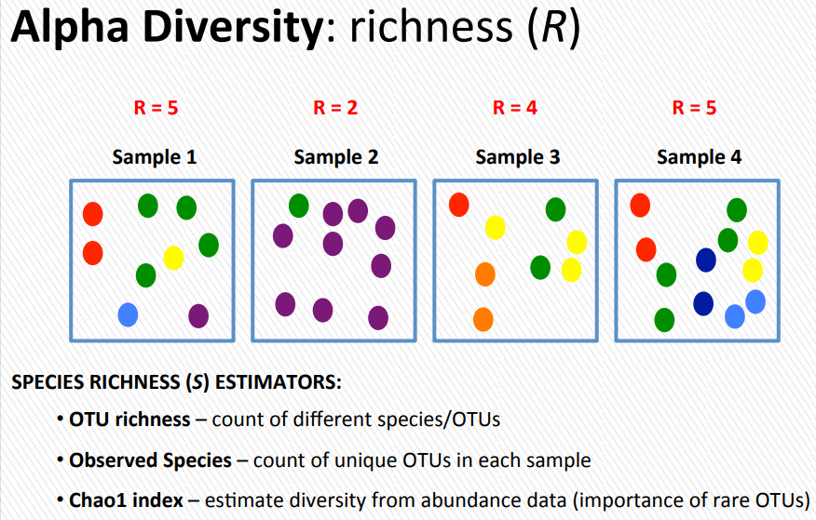
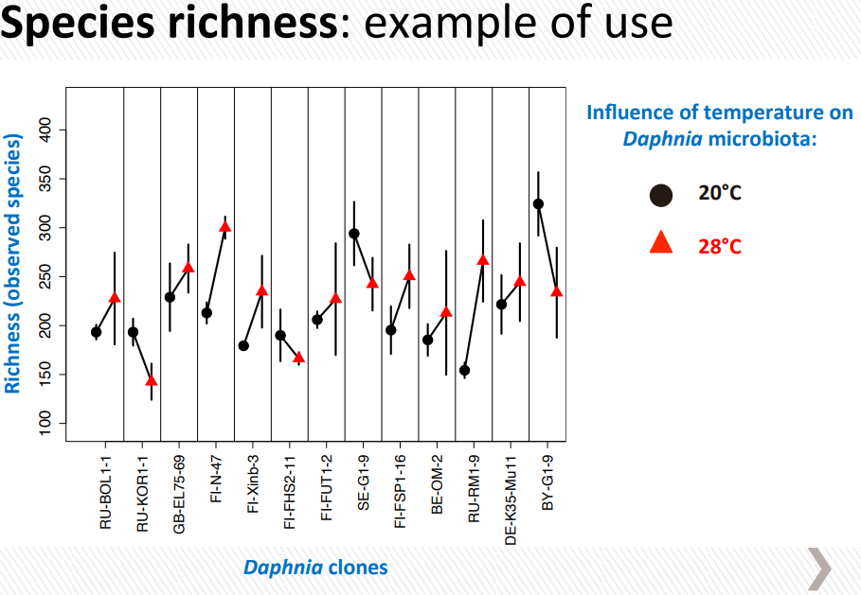
Richness
Measure of the different number of species within a sample.
Measured in a variety of methods: Shannon-Weiner Index, Simpson Index, Chao1 Index, ACE.
"estimate_richness()" function.

Slide 7
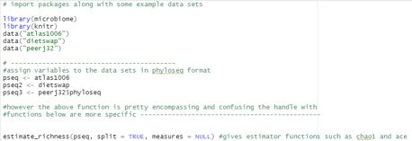
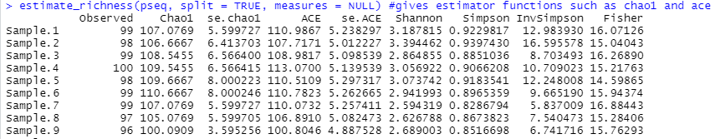
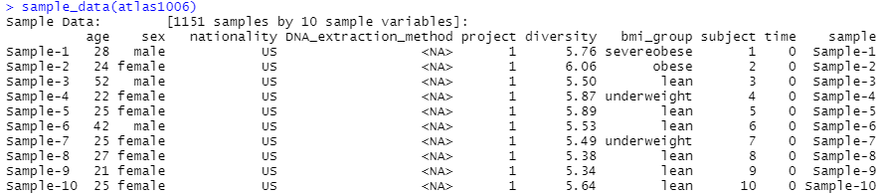
Richness Example

Slide 8
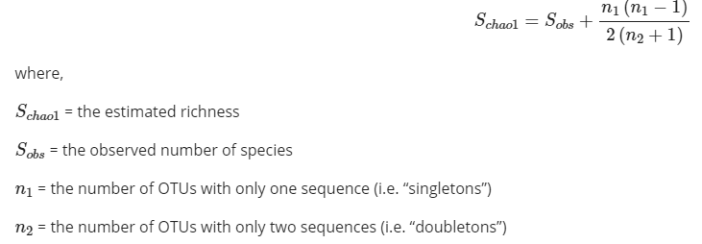
Chao1 Measure
Chao1 is an estimator that calculates the estimate of richness of a given set of samples.
Can use the "estimate_richness" function.
Higher Chao1 values = higher estimated richness.

Slide 9
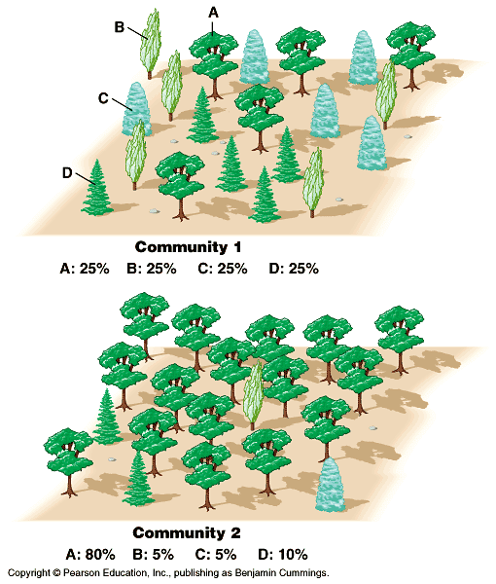


Evenness
Measure of equivalence in amount of each species in a given sample.
Evenness can be calculated and measured using the Pielou's Evenness Index.
"Evenness()" Function.

Slide 10
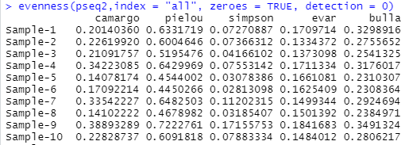
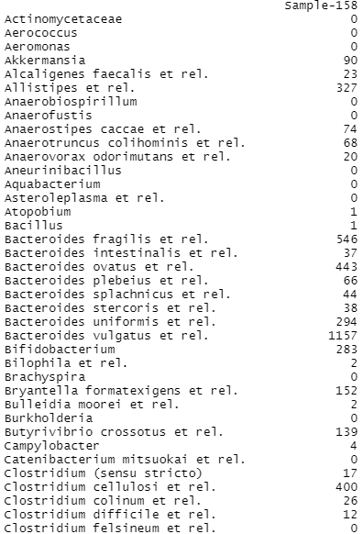
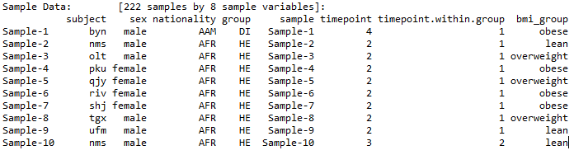
Evenness Example

Slide 11
Dominance
Measure of how much a specific species dominates in count versus others in a sample.
Can be measured using the Simpson and Shannon Indexes.
Negatively, affects diversity.
"dominance()" or "dominant()" function.

Slide 12
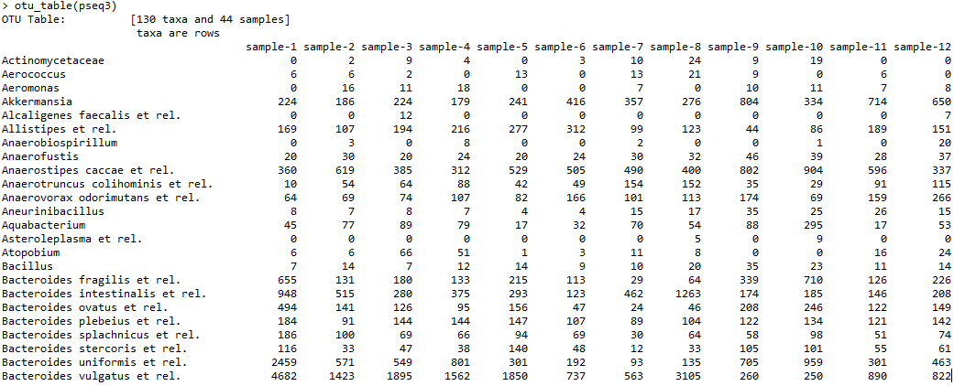
Dominance Example

Slide 13
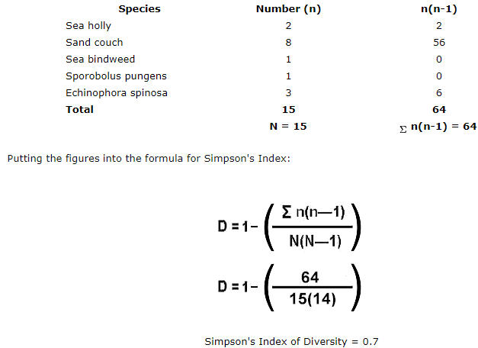

Simpson Index
An index that, considering richness and evenness, measures the diversity of the sample set by being given the number of species along with count of each species.
Often used in its inverse or Gini-Simpson form.
The larger (near 1) the measured value = the more diverse the sample (Gini-Simpson).

Slide 14
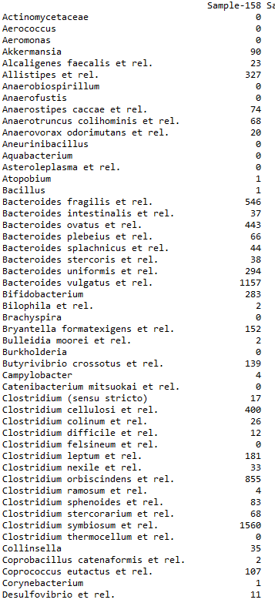
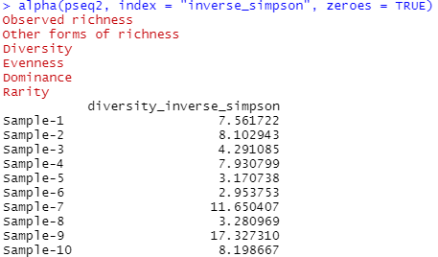
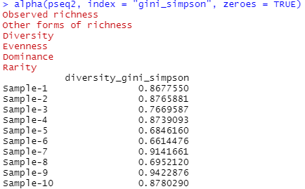
Simpson Index Example

Slide 15
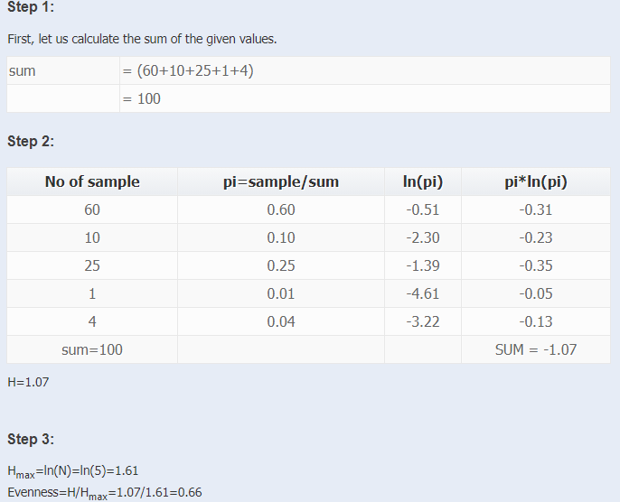

Shannon-Weiner Index
An index that, similar to Simpson, measures the diversity of a given sample set by using the number of individual species along with the counts of each species.
Higher value implies a greater diversity of a given sample set.

Slide 16
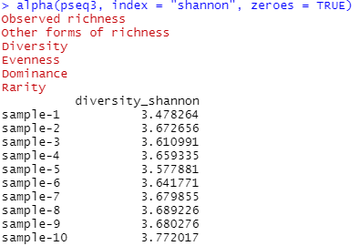
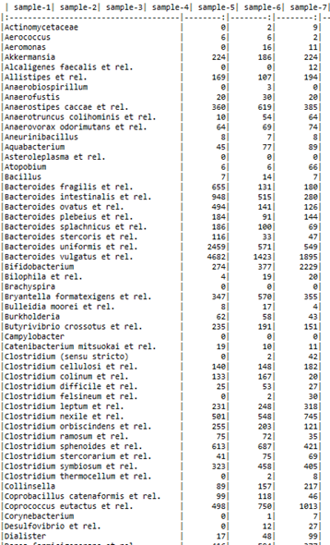
Shannon Index Example

Slide 17
Beta Diversity
Beta Diversity attempts to showcase the differences of species amongst different sample sets (environments).
Measures dissimilarity/divergence which can be measured in several methods.
Bray-Curtis, Jaccard Distance, UniFrac

Slide 18
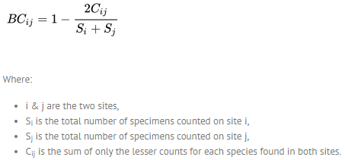
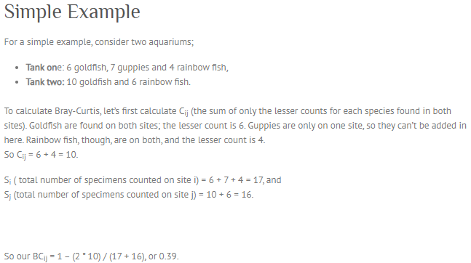
Bray-Curtis Method
A dissimilarity measuring method that compares two sample sites by comparing the differences in abundances between the two.
0 = being the most similar, while 1 = being the least similar.

Slide 19
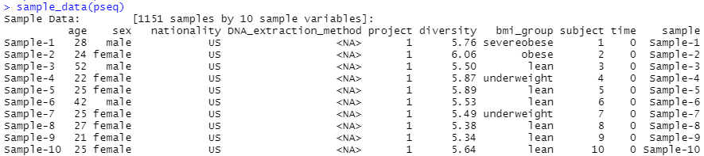
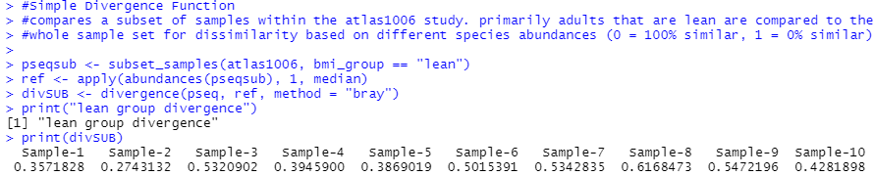
Bray-Curtis Example

Slide 20
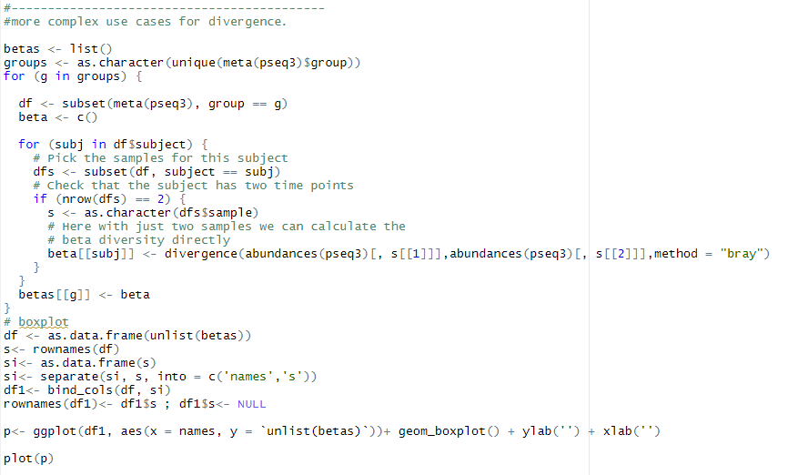
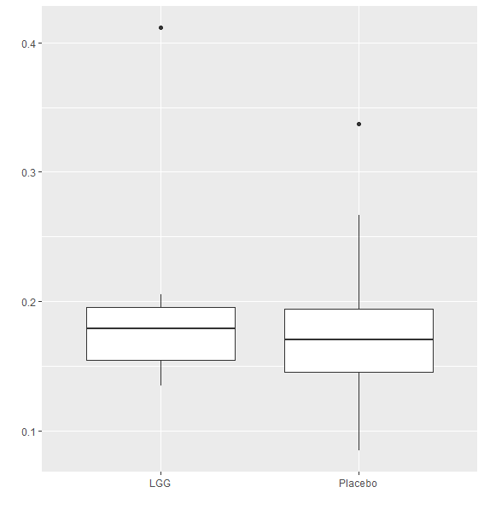
More Advanced Bray Curtis Example

Slide 21
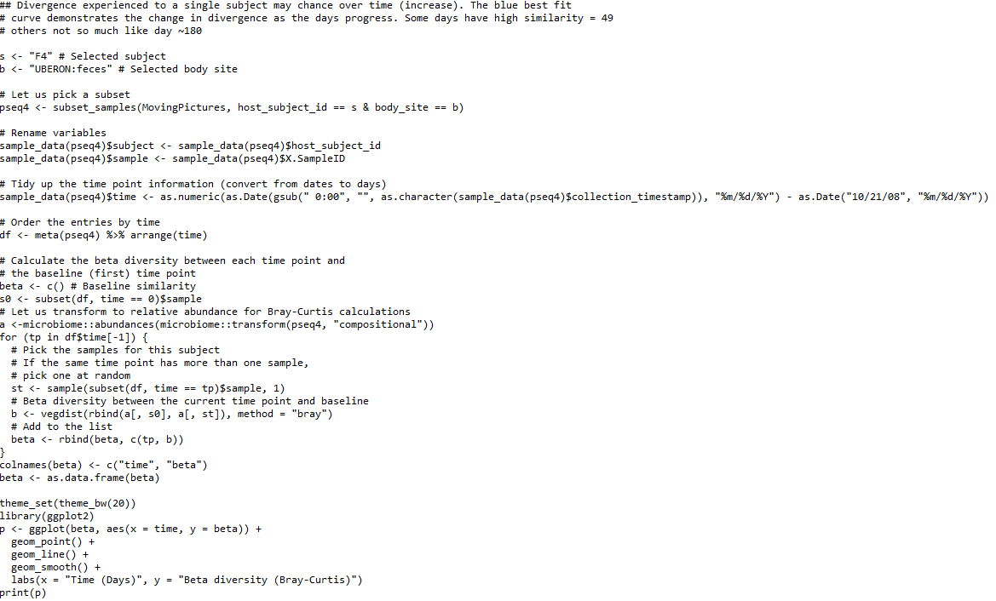
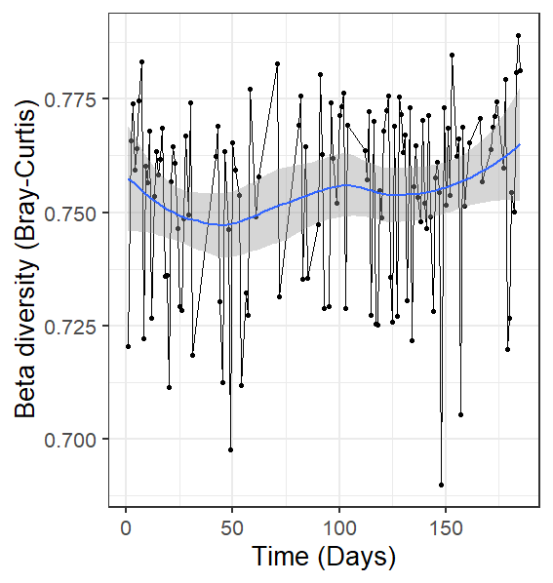
Change in Divergence over Time

Slide 22
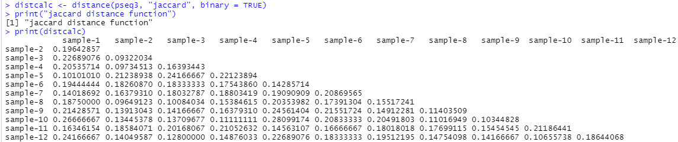
Jaccard Distance Example
Jaccard Method measures the dissimilarity of all the species contain in two sample sets (environments).
0 = both sets have the same set of species, 1 = both sets have no species in common.

Slide 23
Univariate Comparisons
Univariate data involves statistics that only have observations of a single type of data
In Microbiome R there are functions that allows one to make boxplots for the abundance measure as well as testing the paired comparison for a single taxonomic group with a random subject effect

Slide 24
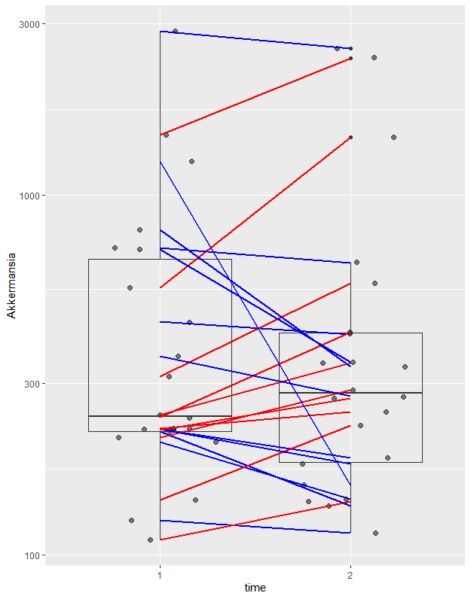
Abundance boxplot
Using the command boxplot_abundance one can get a simple boxplot of the species abundance with time vs akkermansia

Slide 25
LME4
Linear Mixed-Effects Models using 'Eigen' and S4, or LME4 for short, can be used for linear model comparison to test an individual taxonomic group with a random subject effect
out <- lmer(signal ~ group + (1|subject), data = dfs) out0 <- lmer(signal ~ (1|subject), data = dfs) comp <- anova(out0, out) pv <- comp[["Pr(>Chisq)"]][[2]] print(pv)
[1] 0.4556962

Slide 26
Multivariate Comparisons
Multivariate comparisons involve analysis of two or more variables
The Microbiome package for R also has a function to do Permutational Multivariate Analysis of Variance, PERMANOVA for short
PERMANOVA is used to do geometric partitioning of multivariate variation within a given space with a dissimarily measure, such as counts of abundance

Slide 27
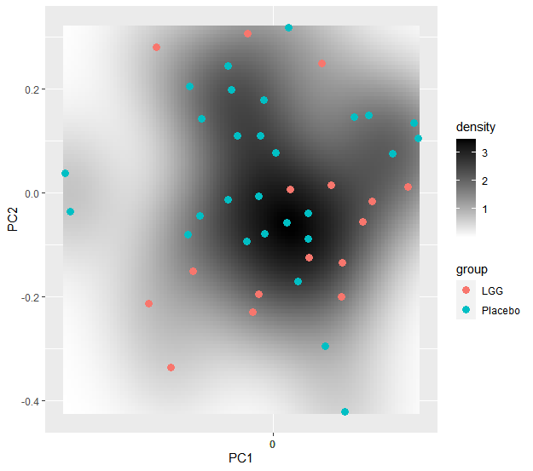
Visualizing Microbiome Variation
Using the plot landscape function, the population density of both a probiotic treament LGC and a placebo can be compared

Slide 28
PERMANOVA
The permanova and adonis commands PERMANOVA can be conducted on a data set
permanova <- adonis(t(otu) ~ group, data = meta, permutations=99, method = "bray")
print(as.data.frame(permanova$aov.tab)["group", "Pr(>F)"])
[1] 0.31

Slide 29
Homogeneity Condition
Analysis of Variance, aka ANOVA, may also be conducted on a dataset to check the variance homogeneity
dist <- vegdist(t(otu))
anova(betadisper(dist, meta$group))
Analysis of Variance Table
Response: Distances
Df Sum Sq Mean Sq F value Pr(>F)
Groups 1 0.000016 0.0000160 0.0043 0.9483
Residuals 42 0.157881 0.0037591

Slide 30
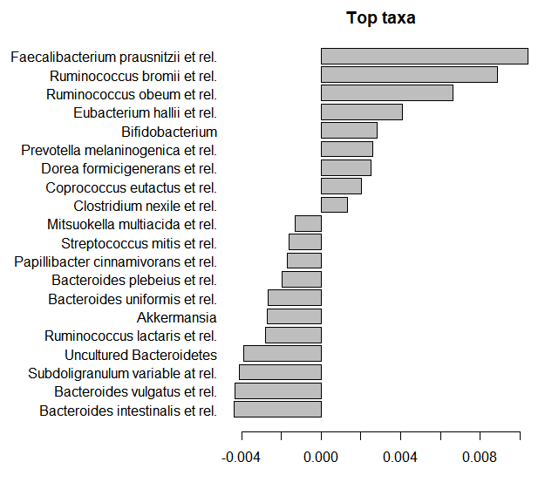
Top Taxa Factors
Using PERMANOVA the coefficients for the top taxa can be computed to show the difference between various groups

Slide 31
References (Diversity)
1. https://socratic.org/questions/how-is-biodiversity-measured
2. http://www.evolution.unibas.ch/walser/bacteria_community_analysis/2015-02-10_MBM_tutorial_combined.pdf
3. https://slidetodoc.com/chapter-4-species-diversity-tables-figures-and-equations/
4. https://besjournals.onlinelibrary.wiley.com/doi/full/10.1111/2041-210X.12462
5. http://www.metagenomics.wiki/pdf/definition/alpha-beta-diversity
6. https://www.easycalculation.com/statistics/learn-shannon-wiener-diversity.php
7. http://rewhc.org/biomeasures.shtml
8. https://geographyfieldwork.com/Simpson'sDiversityIndex.htm#:~:text=Simpson's Diversity Index is a,evenness increase, so diversity increases.
9. https://bioconductor.org/packages/devel/bioc/manuals/microbiome/man/microbiome.pdf
10. https://mothur.org/wiki/chao/
11. http://www.countrysideinfo.co.uk/simpsons.htm
12. https://microbiome.github.io/tutorials/Alphadiversity.html
13. https://microbiome.github.io/tutorials/Betadiversity.html
14. https://www.webpages.uidaho.edu/~beth/rem357_lectures_files/17dominance%20diversity.pdf
15. https://www.statisticshowto.com/bray-curtis-dissimilarity/

Slide 32
References (Variate Analysis)
1. https://sciencing.com/similarities-of-univariate-multivariate-statistical-analysis-12549543.html
2. https://microbiome.github.io/tutorials/Mixedmodels.html
3. https://microbiome.github.io/tutorials/PERMANOVA.html
4. https://cran.r-project.org/web/packages/lme4/index.html
5. https://onlinelibrary.wiley.com/doi/full/10.1002/9781118445112.stat07841

